Slide 1
INTRODUCTION
Problem Statement-1: Effective communications using GIS.
We have created a Self-Healing Technology which helps in disaster management.
When a disaster occurs mobile networks get disrupted due to which there is breakdown in communication in that locality, which hampers the communication between the rescuers and victims.
As a remedy for this situation we have taken an approach which includes the usage of HAPs to restore the mobile networks on a temporary basis for rescue mission.

Slide 2
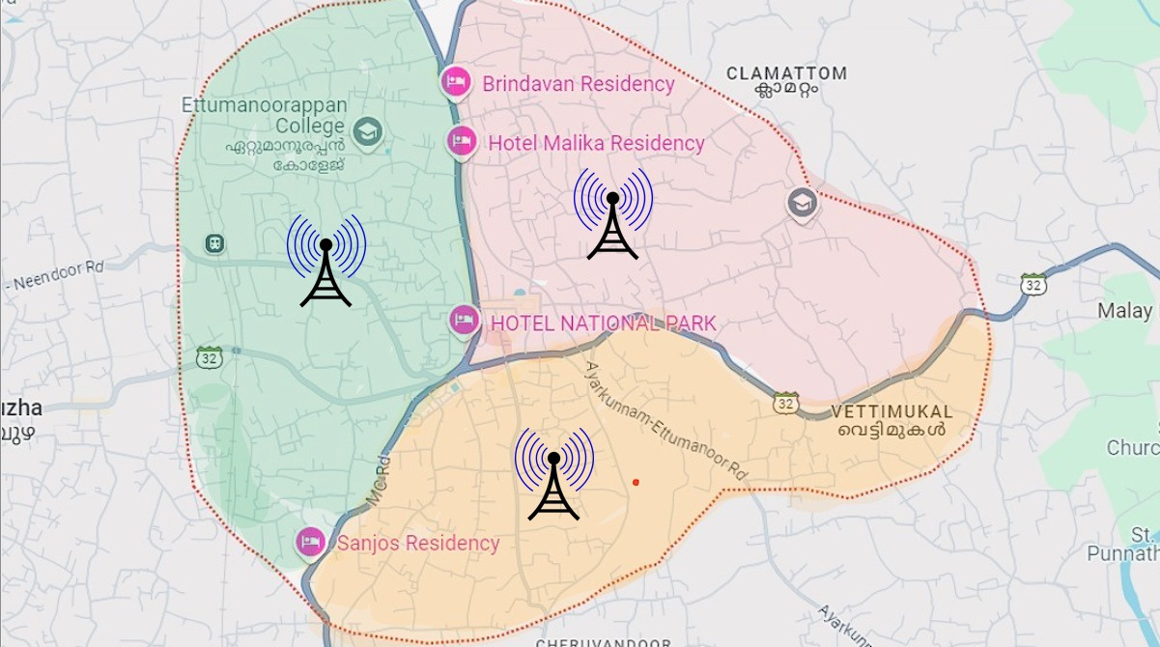
REGIONS
1.Urban Areas: Typically 0.5 to 2 miles (0.8 to 3.2 km)* due to buildings and obstructions.
2.Rural Areas: Can reach 2 to 5 miles (3.2 to 8 km), and up to **20 miles (32 km)* in ideal, flat conditions

Slide 3

Environmental Impacts:- Extreme weather conditions like floods, high winds, snowstorms, or wildfires, landslide can interfere with the proper functioning of mobile towers, damaging equipment, or limiting their signal coverage.
A disaster occurs.

Slide 4
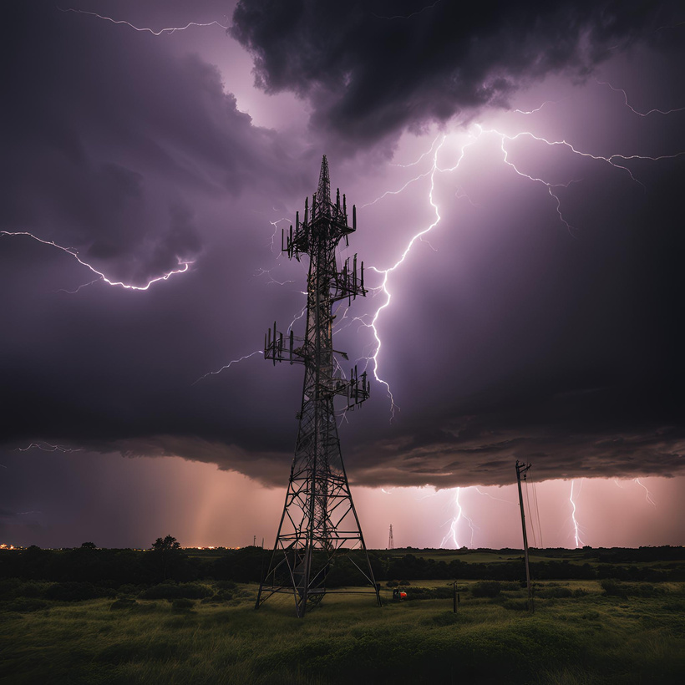
Power cut
Weather Issues
Damage to Tower
Disruption of Backhaul Links
Damage to Mobile Towers

Slide 5

we take input from users and select the sector with least input.....We know that the services are disrupted in that specific sectors by asking YES/NO
Input taken from users

Slide 6
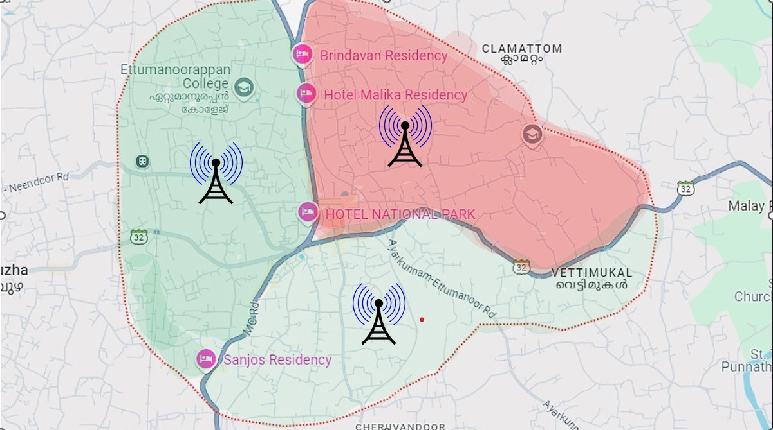
IDENTIFYING THE HOT ZONES
By taking outputs gained On the basis of the input received from the users we put them into an AI system which predicts the sector with the most unanswered users and select it as the HOT ZONE.

Slide 7
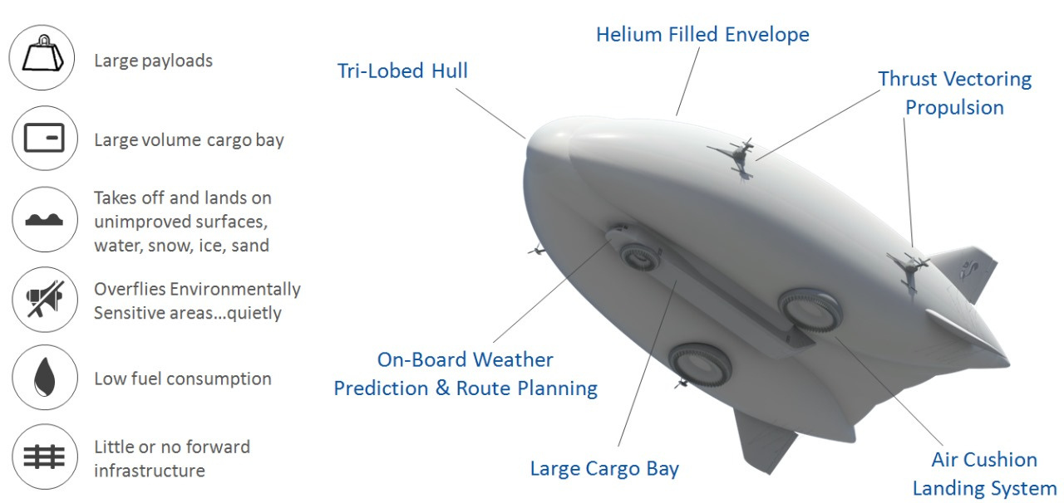
HAPs
High altitude platforms (HAPs) are aircraft or airships or drones that can be used for wireless communication and other applications. They are located in the stratosphere, which is the layer of the Earth's atmosphere that starts at 20 kilometers.

Slide 8
Advantages of HAPS:
1. Coverage: HAPS can provide extensive coverage over large areas, making them useful for remote or underserved locations.
2. Rapid Deployment: They can be deployed relatively quickly compared to traditional ground infrastructure, especially in disaster scenarios.
3. Cost-Effective: They may reduce the need for extensive ground infrastructure, lowering overall costs for communication networks.
4. Flexibility: HAPS can be repositioned to adapt to changing needs or areas of interest.
5. Environmental Monitoring: They can assist in collecting data for environmental monitoring and disaster response.

Slide 9
High Availability Proxies (HAPs) can restore communication in several ways:
1. Failover Mechanisms: Implement automatic failover by using techniques like VRRP (Virtual Router Redundancy Protocol) or clustering. To prevent downtime. If the primary router fails, a secondary takes over.
2. Traffic Management: Prioritize and route traffic based on policies to ensure critical services remain available during peak loads or failures.
3. Cache responses for frequently accessed content, reducing load on backend servers and speeding up recovery after outages.
4. Voice Call Support:- HAPS can relay cellular signals from the ground to mobile devices, similar to how traditional cell towers work. This allows users to make voice calls and send SMS messages in areas where ground infrastructure is damaged or non-existent.

Slide 10
5. Emergency Communication:- In disaster situations, HAPS can ensure that first responders, relief workers, and residents stay connected. This includes not only regular calling but also emergency services and communication for coordination between agencies.
6. Wide Area Coverage: HAPs typically operates at high altitudes (around 20 km), providing broad coverage over large regions, which is especially useful in rural or hard-to-reach areas where regular cell towers are unavailable.
7. Interoperability: HAPs systems are designed to work with existing cellular networks (4G, 5G), making them compatible with most mobile phones without requiring any special devices.

Slide 11
SWOT ANALYIS
STRENGTH:-
FEASIBLE
CAN COVER REMOTE LOCATIONS
TEMPORARY BUT EASY NETWORK
WEAKNESS:-
DIFFICULT TO WITHSTAND HEAVY WEATHER CONDITIONS
CONTINOUS POWER SOURCES

Slide 12
OPPORTUNITIES:-
1. https://elenageosystems.com/static/media/Elena-NDNUv3.4b4f86e7.pdf
2. https://susanfuturetechnologies.com/mobius/

Slide 13
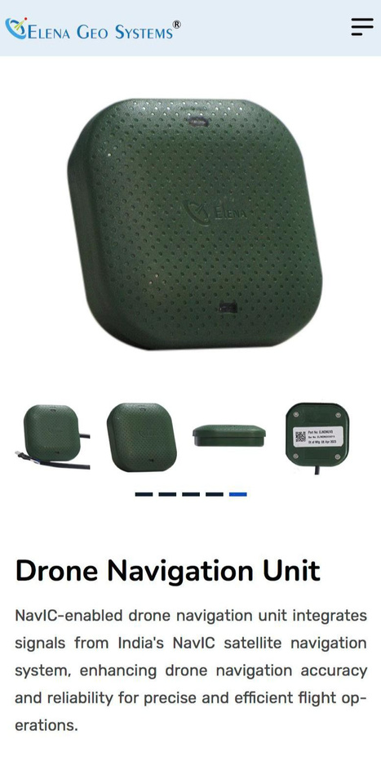
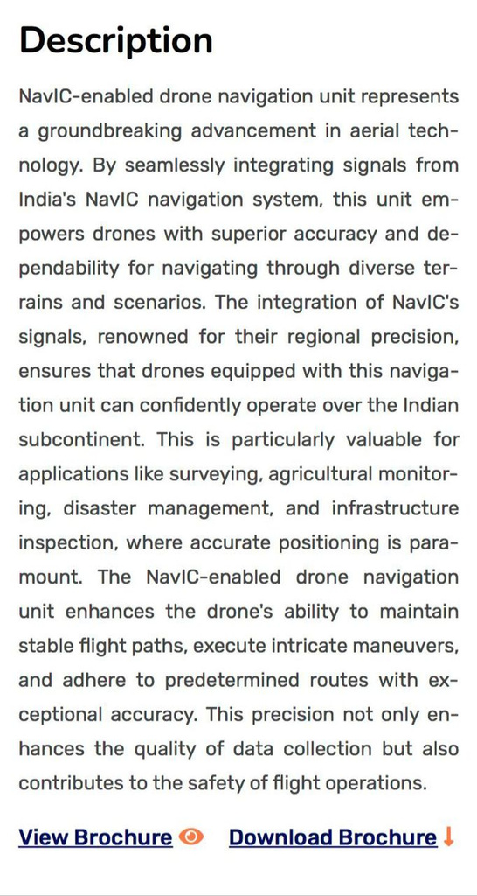
NavIC
NAVIGATION WITH INDIAN CONSTELLATION

Slide 14
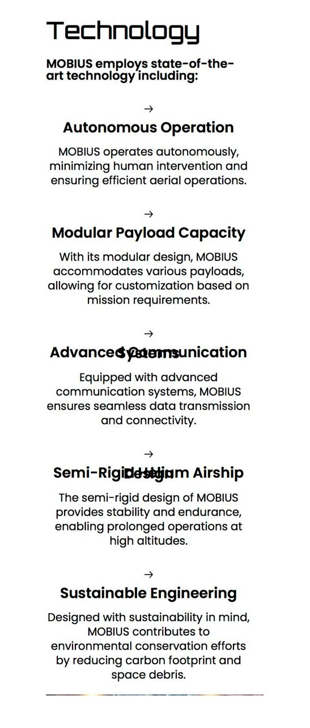
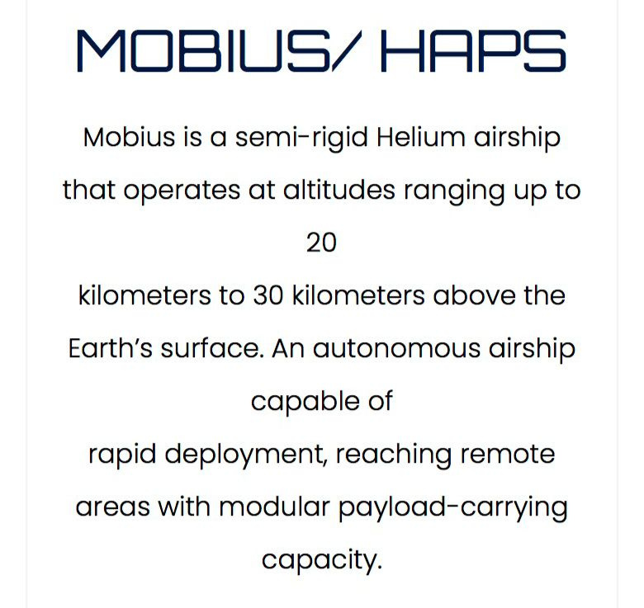

SUSAN FUTURETECHNOLOGY

Slide 15
THREATS:-
BIRD
SECURITY
SOLUTIONS FOR THE THREATS
FOR COLLISIONS USING SENSORS
INCLUSION OF CYBER-SECURITY

Slide 16
CONCLUSION
HAPs restore the communication services between VICTIMS and RESCUERS
due to which timely medical support can be of great help for the victims saving many life.
They can save the temporary data of the disaster which can be very useful in rebuilding the new habitat.

